Slide 1
ID Card Detection uSing Yolo v5
Team Members:
Suryansh Khemka 20BCE1469
Yuvraj Dutt Bajpai 20BCE1523
Kanika Sahni 20BCE1694

Slide 2
ABSTRACT
This paper presents a method for ID card detection that combines image segmentation techniques with the YOLOv5 deep learning model. The project entails identifying a particular tag in photos and videos as well as the ID card's main body. The YOLOv5 model, CVAT.ai for image annotation, and bermi.net for bulk image resizing are all integrated into the methodology. The study advances real-time, accurate ID card detection systems by taking inspiration from different object detection and ID card recognition techniques discussed in related works.
The culmination of these steps results in a robust and automated ID card detection system. The system, operating in real-time, effectively distinguishes individuals with valid ID cards from those without, facilitating secure campus access. This project showcases the power of image processing, deep learning, and computer vision in enhancing campus security and automation.

Slide 3
01
Problem Statement
02
Objectives
Table of contents
03
Literature Survey
04
Methodology and technology
05
Output

Slide 4
01
Problem Statement

Slide 5
Problem statement
Addressing the imperative need for heightened campus security and streamlined access control, the challenge at hand revolves around creating an advanced, automated system for student identification within the VIT (Vellore Institute of Technology) campus. The core objective is to develop a robust solution employing image processing techniques that can efficiently determine whether students entering the premises are wearing their designated VIT ID cards or any valid identification. This system must operate in real-time, adapting to diverse lighting conditions, and, crucially, it should minimize instances of both false positives and negatives. By achieving this, the system aims to enhance overall campus security, ensuring a seamless and secure access control mechanism.

Slide 6
02
OBJECTIVE

Slide 7
This project's main goal is to create an advanced ID card detection system that can guarantee high recall rates and precision while also meeting the real-time requirements of diverse applications. By utilizing the YOLOv5 deep learning model and sophisticated image segmentation methods, this study seeks to advance the development of dependable and effective ID card detection systems.
The paper will go over relevant works in the field, the methodology selected, experimental setups, and the outcomes as we go through the following sections. Additionally, the system's overall efficiency is increased by the integration of tools like bermi.net for bulk image resizing and CVAT.ai for image annotation, which together provide a comprehensive solution for ID card detection.
In summary, this work investigates how to enhance the field of ID card detection by combining cutting-edge deep learning, image segmentation, and useful tools. The results of this study are important not only for the field of security but also for other applications that need accurate object detection in dynamic environments.

Slide 8
03
LITERAture survey

Slide 9
Title: A Study on Object Detection [1]
Abstract: In today's society, the prevalence of video surveillance, particularly the use of video cameras for monitoring various environments, has become commonplace. A significant portion of these surveillance systems relies on human intervention to monitor activities within the designated areas of interest. However, this human-centric surveillance approach presents inherent limitations, including the potential for oversight and fatigue. To address these shortcomings and enhance the efficacy of surveillance, researchers have turned their attention to automated visual surveillance systems.
This paper serves as an invaluable contribution to the field by comprehensively examining the visual surveillance process, which encompasses several pivotal stages. These stages include environment modeling, motion segmentation, object classification, tracking, behavior understanding, human identification, and data fusion. Among these steps, the initial and fundamental one involves the identification of moving objects within a video sequence. These moving objects can vary in nature, encompassing humans, vehicles, and more. Object detection technology plays a central role in this process, as it is responsible for determining the semantic class of the moving objects within the video sequence. Consequently, object detection is a crucial component for both tracking moving objects and analyzing their behavior within the given video sequence.
Recognizing the paramount importance of object detection in the realm of visual surveillance, this paper not only highlights its significance but also presents a comprehensive overview of the various methods and approaches available for object detection. Beyond theoretical discussions, the practical applications of automatic visual surveillance are discussed, including its role in human identification at a distance, congestion monitoring, and the detection of anomalous behaviors. In essence, this paper lays the foundation for understanding the critical role of object detection within automated surveillance systems, offering valuable insights into the broader field of computer vision and security.

Slide 10
Title: Advanced ID Card Recognition Through Region Location and Neural Networks [2]
Abstract: In the modern world, the recognition and management of identification cards (ID cards) have assumed a paramount role, particularly within the realm of image recognition applications. As ID cards serve as fundamental identity certificates for citizens, the process of ID card identification and information management has garnered substantial attention and has evolved into a pressing issue of concern. Within the context of Chinese ID card image recognition, numerous challenges are encountered, primarily stemming from hardware conditions, variable illumination, and the presence of background noise.
This paper seeks to address these multifaceted challenges and proposes an innovative approach to enhance the accuracy and robustness of ID card recognition. Central to this approach is the problem of extracting essential information from ID card images while mitigating the adverse effects of shadow grid lines and noise interference. To tackle this issue effectively, the authors introduce a novel ID card region location method, which relies on both face detection and national emblem detection techniques. This method adeptly locates the foreground target area within the ID card, even amidst complex and cluttered backgrounds.
Moreover, the paper delves into the critical aspect of correcting image rotation, which often occurs due to skewed image capture. Leveraging the Hough transform, the authors propose a method for correcting rotational tilt within the range of angles less than 45 degrees. Further advances are presented in the domain of text localization within the ID card image, employing morphological image processing techniques. The culmination of these methods is the utilization of deep convolutional neural networks (CNNs) for character segmentation and recognition. Notably, the recognition system demonstrates an impressive 99.7% accuracy rate for identifying both Chinese characters and numerical digits.
In summary, this paper offers a compelling insight into the intricate field of ID card recognition by proposing a comprehensive solution that addresses the challenges associated with image acquisition, processing, and recognition. The advancements presented in this research pave the way for more accurate and reliable ID card recognition systems, with the potential to revolutionize identity verification processes and improve security measures.

Slide 11
Title: Design and Implementation of an ID Card Identification System [3]
Abstract: In contemporary society, the utilization of ID card identification technology holds a pivotal role across various sectors, facilitating the establishment of comprehensive information databases within numerous governmental and private entities. This paper takes a comprehensive approach to design and implement an ID card identification system, encompassing multiple critical components.
The system's architecture is designed to fulfill the stringent requirements of accurate and efficient ID card recognition. It encompasses several stages, beginning with image preprocessing, where the acquired ID card image is refined to enhance its suitability for subsequent processing. Following preprocessing, the system delves into character segmentation, a crucial step in extracting individual characters and information from the ID card.
The processing of individual characters is a focal point, ensuring the accurate recognition of characters and symbols present on the ID card. Through a meticulously designed character recognition algorithm, the system achieves a high level of accuracy in character identification. Furthermore, the paper emphasizes the importance of information preservation, ensuring that the recognized ID card data is securely stored and managed for future reference.
The proposed ID card identification system represents a robust solution that aligns with the stringent requirements of modern identity verification processes. Its comprehensive approach addresses each facet of ID card recognition, from image preprocessing to character recognition and data management. As such, this system holds significant potential for various applications that demand precise and efficient ID card recognition.

Slide 12
Title: Advances in Object Detection Techniques: From Traditional Methods to Deep Learning [4]
Abstract: In recent decades, the rapid evolution of information technology has precipitated a profound transformation in data and information management. This transformation encompasses various facets, including data acquisition, data processing, and predictive analytics. Within this interdisciplinary paradigm, image processing techniques and the implementation of AI-based models have emerged as pivotal players, reshaping the landscape of object detection.
This survey paper embarks on a comprehensive exploration of diverse methodologies for object detection. By drawing on the extensive body of literature and research in this field, the paper systematically analyzes existing object detection techniques, offering a well-structured and insightful representation.
The paper serves as a compendium of knowledge, providing readers with a profound understanding of the merits and demerits associated with various object detection methods. Notably, the survey delves into the future prospects and potential advancements within this domain, shedding light on the exciting avenues awaiting exploration.
In conclusion, this survey paper serves as a beacon of knowledge in the field of object detection, offering readers a comprehensive understanding of the historical evolution, current state, and future prospects of object detection techniques. It reflects the remarkable strides made in this field and underscores the role of machine learning and deep neural networks in shaping the future of object detection.

Slide 13
Title: Object Detection using YOLO: A Survey [5]
Abstract:
The domain of computer vision has witnessed a surge in interest and innovation, particularly in the realm of object detection. Object detection, a foundational task in computer vision, finds applications in diverse fields, such as vehicle detection, pedestrian tracking, and medical image analysis. This paper addresses recent developments in object detection, with a particular focus on the groundbreaking "You Only Look Once" (YOLO) approach, which has garnered significant attention for its ability to achieve real-time object detection by formulating it as a regression problem.
The YOLO framework represents a paradigm shift in object detection, allowing for the simultaneous prediction of multiple objects within a single image. This paper conducts a comprehensive survey of various modifications and enhancements made to the core YOLO method, all aimed at improving detection accuracy and speed. The survey encompasses a range of YOLO-based approaches, each contributing unique insights and methodologies to the field. The paper thoroughly analyzes these modifications and presents their respective performance analyses, offering a holistic view of the state-of-the-art in YOLO-based object detection.

Slide 14
Title: Indonesian ID Card Recognition using Convolutional Neural Networks [6]
Indonesian Citizen ID Cards serve as essential documents for identity verification in numerous transactions, ranging from sales and purchasing records to admission processes. The conventional method of manually entering citizen ID card data is time-consuming, error-prone, and inefficient. In response to these challenges, this research introduces a novel approach that harnesses the power of deep learning, specifically Convolutional Neural Networks (CNNs), for citizen ID card detection.

Slide 15
Title: CNN Based Moving Object Detection from Surveillance Video in Comparison with GMM [7]
Abstract:
In contemporary intelligent detection and visual monitoring systems, the classification of moving objects has assumed paramount importance. The recognition of moving objects in images and the categorization of vehicle types represent critical components of effective visual surveillance systems. To enhance the real-time performance and accuracy of moving object classification, this paper explores the application of Convolutional Neural Networks (CNNs), a deep learning-based approach.
The paper conducts a comparative analysis between CNN-based object detection and Gaussian Mixture Model (GMM)-based object detection. The results reveal the superiority of CNNs, with a mean accuracy of 95.69% compared to 93.22% for GMM. Similarly, the mean F-score for CNN is 87.02, surpassing GMM's mean F-score of 84.77. This research showcases the potential of CNNs in swiftly and accurately recognizing moving objects, offering a robust alternative to traditional methods. The findings underscore the importance of deep learning in advancing object detection in visual surveillance applications.
The research investigates the feasibility and effectiveness of CNNs in recognizing Indonesian Citizen ID Cards, offering a substantial improvement in accuracy and efficiency compared to traditional computer vision techniques. The results showcase the positive impact of deep learning on citizen ID card recognition, presenting a promising alternative to the labor-intensive manual data entry approach. Additionally, the paper conducts a comparative analysis between CNN-based recognition and conventional computer vision techniques, shedding light on the advantages and potential applications of deep learning in the realm of citizen ID card detection.

Slide 16
Title: Improvement of Object Detection Based on Faster R-CNN and YOLO [8]
Abstract:
The evolution of artificial intelligence technology has been significantly influenced by advancements in object detection techniques. Notably, the "You Only Look Once" (YOLO) v2 object detector has gained recognition for its real-time detection capabilities and high accuracy. However, despite its computational efficiency, YOLO v2 may not match the accuracy achieved by two-stage detectors like Faster R-CNN. This paper explores the fusion of these two algorithms using the Kalman filter to enhance object detection accuracy.
In this innovative approach, Faster R-CNN's results are employed as observations due to their superior accuracy, while YOLO v2's outcomes serve as state variables. The experimentation is conducted on video samples containing vehicle images. The results demonstrate that the fusion of these two algorithms via the Kalman filter yields enhanced object detection accuracy, offering a promising solution for applications where both speed and precision are paramount.

Slide 17
Title: "FVI: An End-to-end Vietnamese Identification Card Detection and Recognition in Images" [9]
Methodology
The paper introduces the "FVI" system, an end-to-end Identification Card Recognition system. This system boasts the capability to rapidly detect ID cards, recognize text, and extract essential information from these cards. It also presents innovative modelling techniques for efficient text detection and recognition.
Evaluation
To gauge the system's effectiveness, the paper conducts extensive evaluations, subjecting it to various testing scenarios and datasets.
Large-scale Testing: The system is put to the test on a large scale, simulating scenarios where a significant volume of ID cards needs to be processed in a short time frame. This reflects real-world applications such as access control at events, secure entry points, and identity verification.
Accuracy Metrics: The paper employs a range of accuracy metrics to assess the system's performance. These metrics include detection accuracy, text recognition accuracy, and overall information extraction precision.
Robustness Testing: The system's robustness is tested against different challenges, including variations in lighting conditions, image quality, and ID card designs. Robustness is a crucial factor, ensuring the system's reliability under diverse conditions.
Additional Insights
Apart from the content of the paper, it is essential to consider the broader implications of such a system. The integration of end-to-end ID card recognition systems can enhance security at various entry points and streamline access control in diverse settings.
This pioneering paper addresses the imperative need for efficient ID card recognition systems by proposing an end-to-end Identification Card Recognition system. The system's core functionality lies in its ability to swiftly detect ID cards, recognize text, and extract crucial information from these cards. Beyond this, the paper outlines innovative modeling techniques for the efficient detection and recognition of text. Furthermore, it unveils the architectural blueprint of FVI, a system currently in deployment across several organizations. Extensive evaluations serve as a testament to the system's efficacy, especially when applied to large-scale detection and recognition tasks involving constrained forms.

Slide 18
TECHNIQUES USED
6. Indonesian ID Card Recognition using Convolutional Neural Networks
•Techniques: ID card recognition, Convolutional Neural Networks (CNNs)
•Algorithms: CNNs for ID card recognition
7. FVI: An End-to-end Vietnamese Identification Card Detection and Recognition in Images
•Techniques: ID card detection, text recognition
•Algorithms: Object detection algorithms for ID card detection, text recognition techniques
8. A System to Localize and Recognize Texts in Oriented ID Card Images
•Techniques: Text localization, text recognition
•Algorithms: Image processing techniques for text localization, text recognition algorithms
9. Citizen ID Card Detection using Image Processing and Optical Character Recognition
•Techniques: ID card detection, image processing, Optical Character Recognition (OCR)
•Algorithms: Image processing algorithms for ID card detection, OCR algorithms
10. A System to Localize and Recognize Texts in Oriented ID Card Images
•Techniques: Text localization, text recognition
•Algorithms: Image processing techniques for text localization, text recognition algorithms
1. A Study on Object Detection
•Techniques: Visual surveillance, object detection
•Algorithms: Various object detection methods
2. Advanced ID Card Recognition Through Region Location and Neural Networks
•Techniques: ID card recognition, region location, neural networks
•Algorithms: Neural networks for text region recognition
3. Design and Implementation of an ID Card Identification System
•Techniques: ID card identification, image preprocessing, character segmentation
Algorithms: Image preprocessing techniques, character segmentation algorithms
4. Advances in Object Detection Techniques: From Traditional Methods to Deep Learning
•Techniques: Object detection, traditional methods, deep learning
•Algorithms: Traditional object detection methods, deep neural networks
5. Object Detection using YOLO: A Survey
•Techniques: Object detection, YOLO framework
•Algorithms: YOLO-based object detection techniques

Slide 19
04
Methodology
AND TECHNOLOGY

Slide 20
Data collection:
Custom dataset: This means that the dataset used in the project is not an existing or publicly available dataset, but it is collected specifically for the project and needs. In relation to identification cards, this may include taking pictures of the identification cards with cameras or other imaging devices.
Image annotation:
CVAT.ai: CVAT (Computer Vision Annotation Tool) is a popular open source annotation tool used to annotate images and videos for computer vision related tasks. In this context, CVAT.ai is probably the version or instance of CVAT used in the project.
Image Segmentation: Image tagging means marking or labeling certain objects or areas in an image. In the case of ID cards, segmentation probably means drawing borders around the ID card itself and possibly marking or labeling certain features on the card, such as text fields, photos or security features.
ID segmentation:
Image segmentation into ID cards: This refers to the extraction and cropping of image ID cards. ID card segmentation is crucial for training computer vision models to accurately recognize and process ID cards. Segmentation techniques can include manual annotation, where human annotators draw boundaries on ID cards, or more sophisticated methods such as semantic segmentation, where algorithms automatically detect and delineate object boundaries.
Signs:
Image Markup: Markup means adding metadata or titles to specific objects or image regions. Marking in connection with an identity card may include marking various parts of the identity card, such as name, date of birth, photograph and other relevant information. This annotated information is important for supervised learning algorithms that learn from annotated examples.

Slide 21
Different angles and lighting conditions:
Different data: Mentioning different angles and lighting conditions indicates that the data set is diverse and represents the variability that the model may encounter in real-world scenarios. This diversity is crucial for teaching robust models that can be generalized to a wide variety of situations.
YOLOv5:
The key aspects of the YOLOv5 architecture:
Object Detection:
Real-time Object Detection: YOLOv5 is designed for real-time object detection, making it suitable for applications where quick and accurate detection of objects in images or video frames is crucial.
Neural Network Layers
Multiple Layers: YOLOv5 consists of multiple layers of neural networks. The architecture typically includes convolutional layers, pooling layers, and fully connected layers. These layers work together to learn hierarchical features from the input data.
Efficiency:
Efficient Architecture: YOLOv5 is chosen for its efficiency, meaning it achieves high accuracy in object detection while maintaining fast processing speeds. This efficiency is crucial for real-time applications where inference speed is a critical factor.
Learning Features:
Automatically Learning Features: YOLOv5, like its predecessors, employs a deep neural network to automatically learn features from the input data. This learning process allows the model to understand and represent complex patterns and features in images, enabling it to identify and locate objects.

Slide 22
ID Card Detection:
Enhancing Accuracy: Image segmentation is employed in the project to enhance the accuracy of ID card detection. This means that instead of treating the entire ID card as a single object, segmentation allows the model to identify and outline the individual components or regions within the ID card, such as the card itself, text fields, photos, and other relevant details.
Localization Precision: By employing image segmentation, the model can precisely locate and delineate the boundaries of each segment within the ID card, leading to more accurate and detailed localization of different elements.
Benefits of Image Segmentation:
Fine-grained Analysis: Image segmentation provides a fine-grained analysis of the content within an image, allowing the model to understand the spatial distribution of different features.
Handling Complex Scenes: In cases where ID cards may be partially obscured, tilted, or overlapping with other objects, image segmentation helps in handling such complex scenarios by providing a pixel-level understanding of the image.
Techniques Used in Image Segmentation:
Manual Annotation: One common approach to image segmentation involves manual annotation, where human annotators mark the boundaries of different regions within the ID card.
Semantic Segmentation: Advanced techniques such as semantic segmentation may also be used. In semantic segmentation, the model automatically assigns a specific label or class to each pixel in the image, effectively dividing the image into semantically meaningful segments.
Integration with Object Detection:
Complementary to Object Detection: Image segmentation is often used in conjunction with object detection. While object detection provides bounding boxes around objects, segmentation adds an additional layer of detail by precisely outlining the contours of each object or region.

Slide 23
TOOLS USED
A. CVAT.ai
One key component of our methodology is the synergy between CVAT.ai and the YOLOv5 model. The meticulous annotation of images was made easier by the use of CVAT.ai, an advanced image annotation tool. Because of the platform's capabilities, a well-labeled dataset could be created, which is a necessary first step towards training a reliable and accurate model. The annotated dataset—which was enhanced with thorough labels—made a substantial contribution to the model's capacity to identify and locate tags and ID cards within photos.
B. bermi.net
The difficulties with image preprocessing—more especially, bulk image resizing—were resolved by incorporating bermi.net into our workflow. The preprocessing step was streamlined by the flexible image resizing tool bermi.net, guaranteeing consistency and uniformity in the dataset. This step is essential for maximizing the performance of the model because it reduces the possibility of biases resulting from differences in image sizes. Our ID card detection system's dependability and effectiveness are further reinforced by the smooth connection between bermi.net and the YOLOv5 model. This section explores the usefulness of these integrations, explaining how each tool makes a positive impact on our methodology as a whole.

Slide 24
05
output

Slide 25

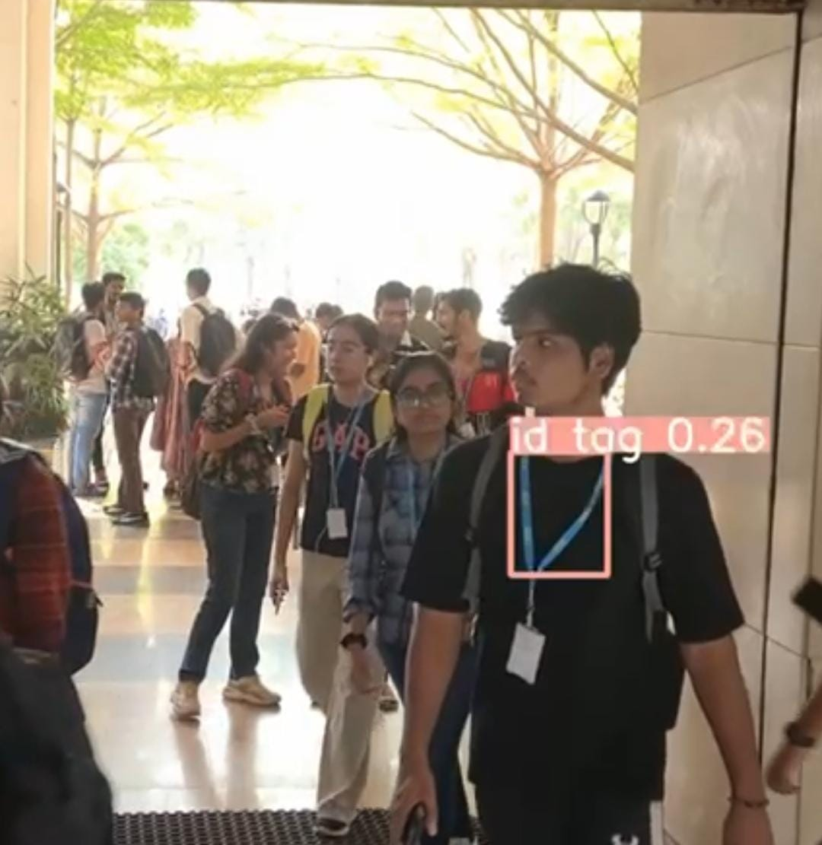

Slide 26
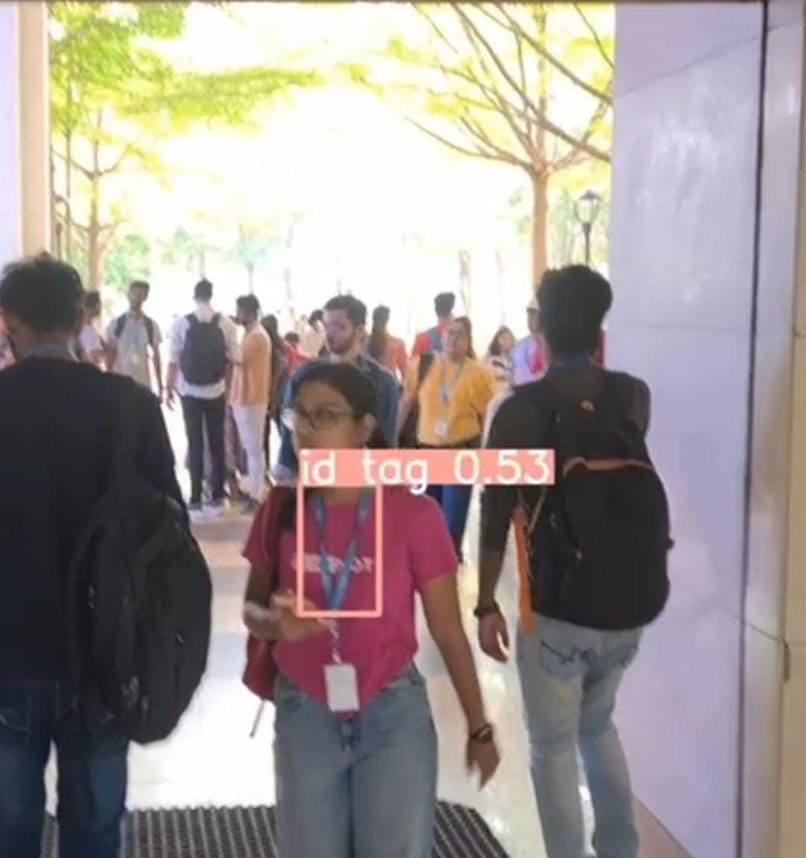
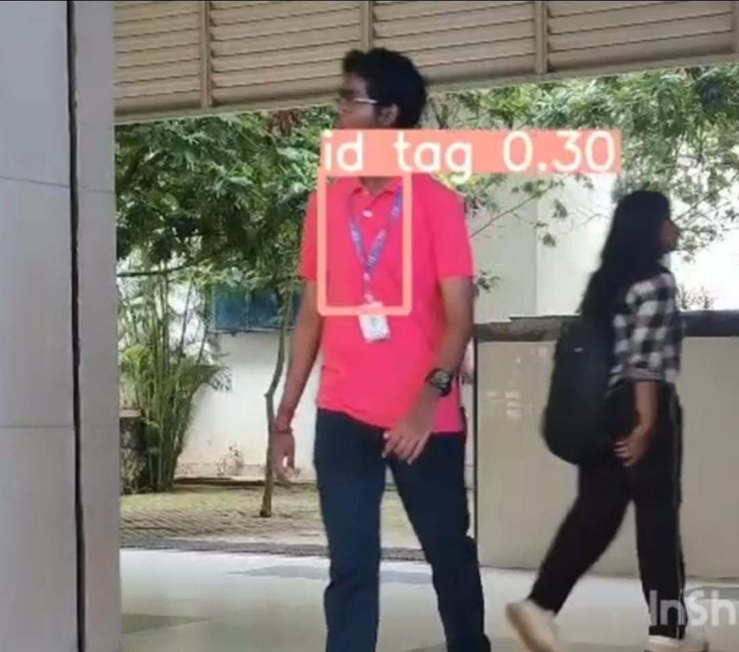

Slide 27
REFERENCES
[1] https://d1wqtxts1xzle7.cloudfront.net/95552136/818-ML0042-libre.pdf?1670722703
[2] http://www.ijsps.com/uploadfile/2013/1204/20131204100316597.pdf
[3] https://ieeexplore.ieee.org/abstract/document/8706303
[4] https://ieeexplore.ieee.org/abstract/document/8606831
[5] https://ieeexplore.ieee.org/document/10073281
[6] https://ieeexplore.ieee.org/document/8752769
[7] https://ieeexplore.ieee.org/document/10028909
[8] https://ieeexplore.ieee.org/document/9501480
[9] https://ieeexplore.ieee.org/document/9132871
[10] https://ieeexplore.ieee.org/document/8283074

Slide 28
Thankyou

